Slide 1
Learning

Slide 2
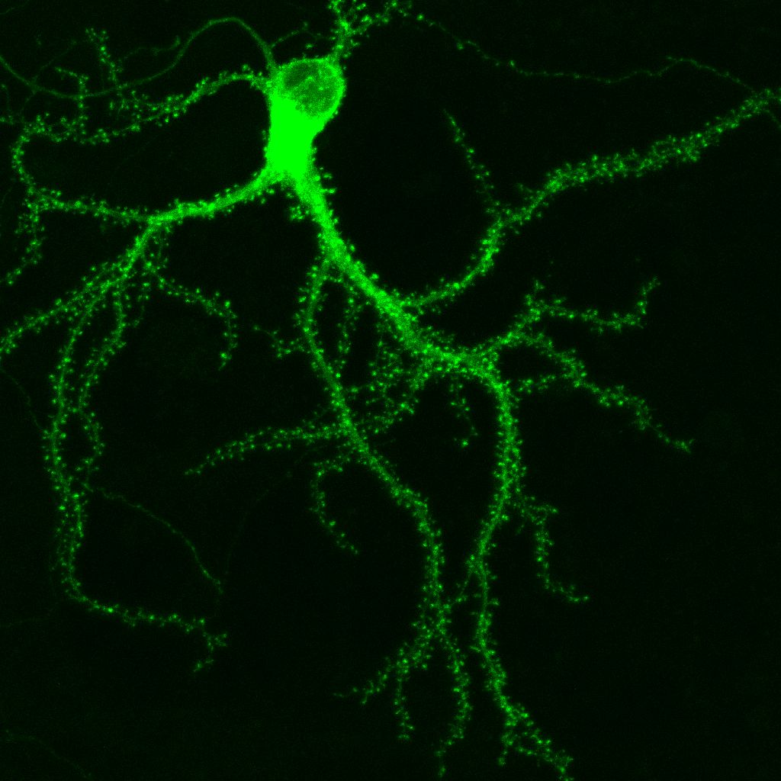
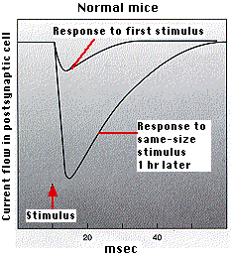
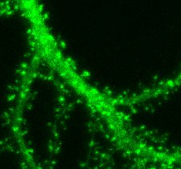
Information is stored in a Neural Network by the Strength
of its Synaptic Connections
Growth or new
generation of
contact points
Contact points
(syn. Spines)
for other
neurons
Up to 10000 Synapses
per Neuron

Slide 3
Learning and Memory
Learning:
Learning Types/Classes and Learning Rules (Overview)
Conceptualizing about Learning
Math (Rules, Algorithms and Convergence) together with the
Biological Substrate for different learning rules and
Biological- and some other Applications (Pattern Recogn.,
Robotics, etc.)
Memory:
Theories
Biological Substrate
Integrative Models – towards Cognition

Slide 4
Time Scales
Short-term memory
Memory
Working memory
Long-term memory
msec
sec
min
hrs
days
years
Activity
Long-term plasticity
Physiology
Short-term
plasticity
Structural plasticity
Tetzlaff et al. (2012). Biol. Cybern.

Slide 5
Different Types/Classes of Learning
Unsupervised Learning (non-evaluative feedback)
Trial and Error Learning.
No Error Signal.
No influence from a Teacher, Correlation evaluation only.
Reinforcement Learning (evaluative feedback)
(Classic. & Instrumental) Conditioning, Reward-based Lng.
“Good-Bad” Error Signals.
Teacher defines what is good and what is bad.
Supervised Learning (evaluative error-signal feedback)
Teaching, Coaching, Imitation Learning, Lng. from examples and more.
Rigorous Error Signals.
Direct influence from a Teacher/teaching signal.

Slide 6
Learning Speed
Autonomy
Correlation based learning: No teacher
Reinforcement learning , indirect influence
Reinforcement learning, direct influence
Supervised Learning, Teacher
Programming

Slide 7
Open Loop versus Closed Loop Systems
Animal
Animal
Env.

Slide 8
The Difference between Input and Output Control
Designer
Output Control
through observation
of the agent
External Value systems
Input Control
at the agent’s
own sensors
True internal
Value systems
Reinforcement
Agent
Evaluative Feedback
(Klopf 1988)
Env.
Non- Evaluative Feedback

Slide 9
Is this a “real” or just an “academic” Problem: Why would we want Input Control ?
Designer
Output Control
through observation
of the agent
Wrong
Reinforcement
Agent
Are we observing the right
aspects of the behaviour ?
(The right output variables?)
Input Control
at the agent’s
own sensors
Env.
The Output control paradigm can and does lead to major problems in
reinforcement learning, because the wrong behaviour might be reinforced.

Slide 10
Prior knowledge
and shared goals
help!
A “funny”
example
“Marsian” observer
with other Sensors and/or
other Goals
Reinforces my running around
Bodyheat
My perception of your
attentiveness
Agent with own Goals
(Me !)
Input Control Loop:
Allows me to control my lecture
and to learn to improve
Environment
(You !)
Speech

Slide 11
Relevance for Learning:
Use output control to get a system that does what YOU want. (engineering system)
Use Input control to get an autonomous (biologically motivated system).
Other considerations:
Learning Speed
Autonomy
Correlation based learning: No teacher
Reinforcement learning , indirect influence
Reinforcement learning, direct influence
Supervised Learning, Teacher
Programming

Slide 12
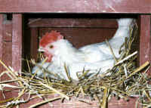
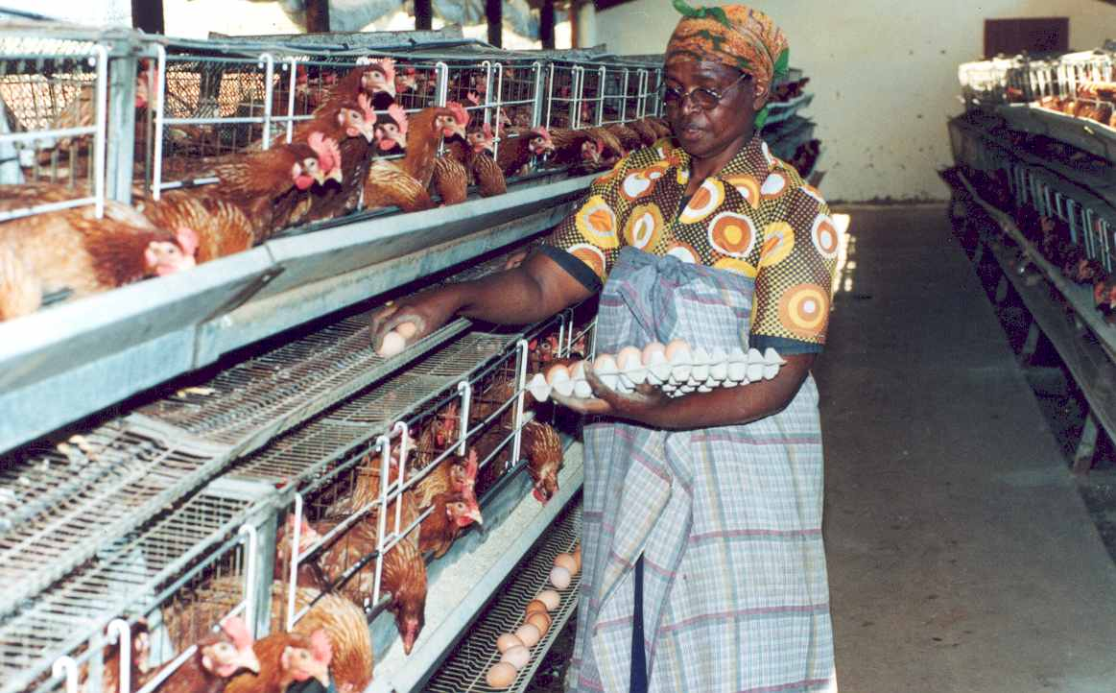
Here a Chicken-Egg Problem of Type II ☺
Control of my Input
(I, chook, want to feel an egg under my butt):
I, chook, would like to sit on
this egg as long as required
to hatch .
Control of its Output:
I, farmer, would like to get
as many eggs as possible and take
them away from the chook.
A fundamental Conflict
Autonomy
Control from inside
Servitute
Control from Outside

